Slide 1

IoT Honeypot System
Salim Khan CIIT/FA21-BCS-193/ATD
Zakirullah Salar CIIT/FA21-BCS-186/ATD
Mohammad Zahid Rahmat CIIT/FA21-BCS-222/ATD
Sayed Shahab Zarin
Department of Computer Science
COMSATS University Islamabad, Abbottabad Campus

Slide 2
Agenda

Slide 3
Brief Introduction
The IoT Honeypot System simulates vulnerable IoT environments to detect and analyze cyber threats. It captures attack data, provides real-time insights, and supports anomaly detection and trend analysis. With advanced features like training models, it helps organizations strengthen IoT security and stay ahead of emerging threats

Slide 4

Scope
This project aims to develop an IoT-Based Honeypot Network for improved cybersecurity threat detection and analysis it:
Simulate IoT communication protocols to mimic real-world scenarios.
Provide real-time attack visualization for better monitoring.
Utilize machine learning for threat prediction and analysis.
Create a user-friendly web application for monitoring and analysis.
Focus on collecting data specific to IoT attacker behavior.
Exclusions:
No mobile app development.
No physical hardware provision.
No analysis of non-IoT protocols

Slide 5

Functional Requirements
Simulate IoT Protocols: Emulate various IoT protocols to attract attackers.
Monitor Real-Time Attacks: Provide live tracking and logging of ongoing attacks.
Generate Alerts: Notify administrators of detected attacks with relevant details.
Analyze Attack Data: Store and provide tools for examining attack patterns and behaviors.
Train ML Models: Enable training of machine learning models using attack data.

Slide 6

Visualize Data: Present attack insights with customizable charts and graphs.
Data Logging: Record all attack interactions securely for future analysis.
Access Control: Implement role-based access for administrators and attackers.
Scalability: Handle multiple simultaneous attack scenarios efficiently.
Security: Isolate the honeypot and encrypt all sensitive data.
Reporting: Generate exportable reports summarizing attack trends and system performance.

Slide 7
Non-Functional Requirements
Performance Requirements:
The system shall handle 100+ simultaneous attack sessions without lag.
The system shall load visualizations/reports within 3 seconds for datasets under 1 GB.
Reliability Requirements:
The system shall achieve 99.9% uptime with a maximum downtime of 1 hour per month.
The system shall recover from failures within 5 minutes from the last checkpoint.

Slide 8
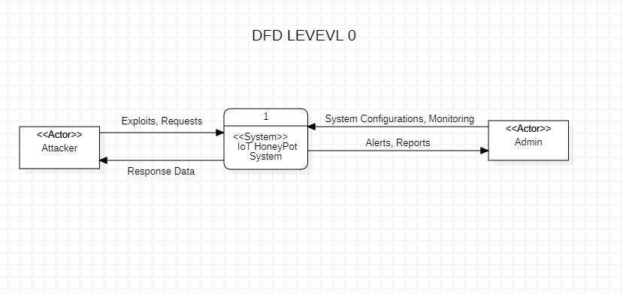
DFD Level 0

Slide 9
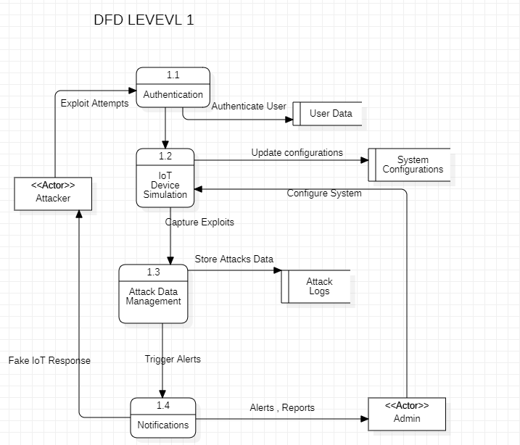
DFD LEVEL 1

Slide 10
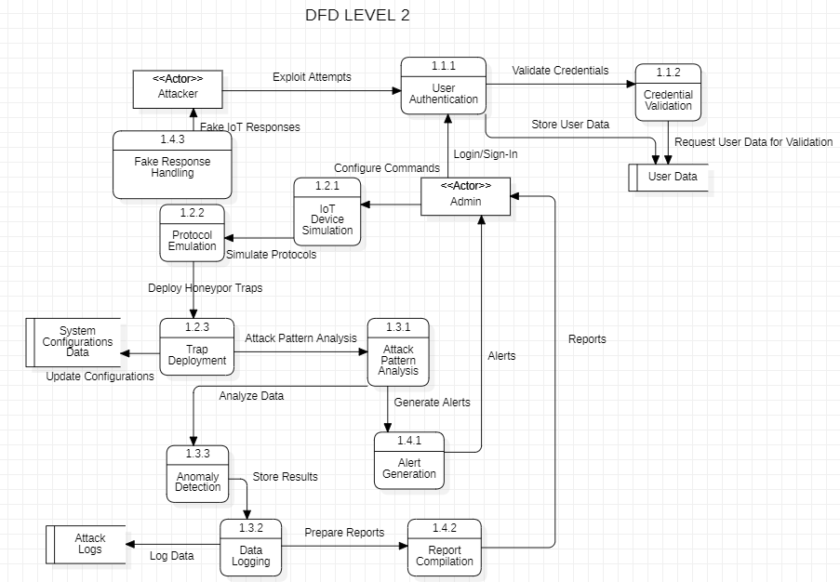
DFD LEVE

Slide 11
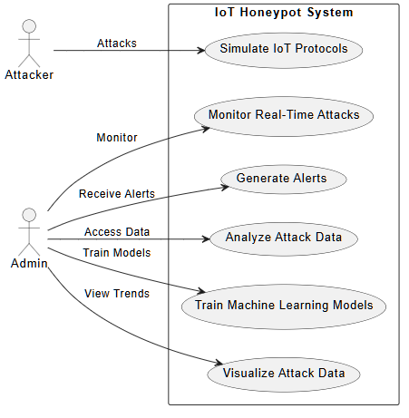
Use Cases Diagram

Slide 12
Summary of 30% Project Implementation

Slide 13
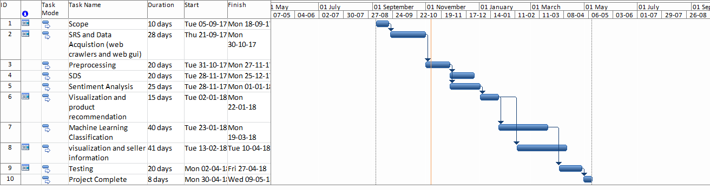
Gantt Chart

